Slide 1

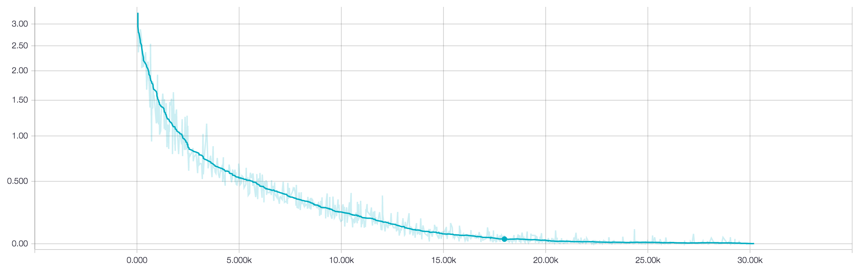
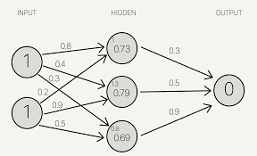
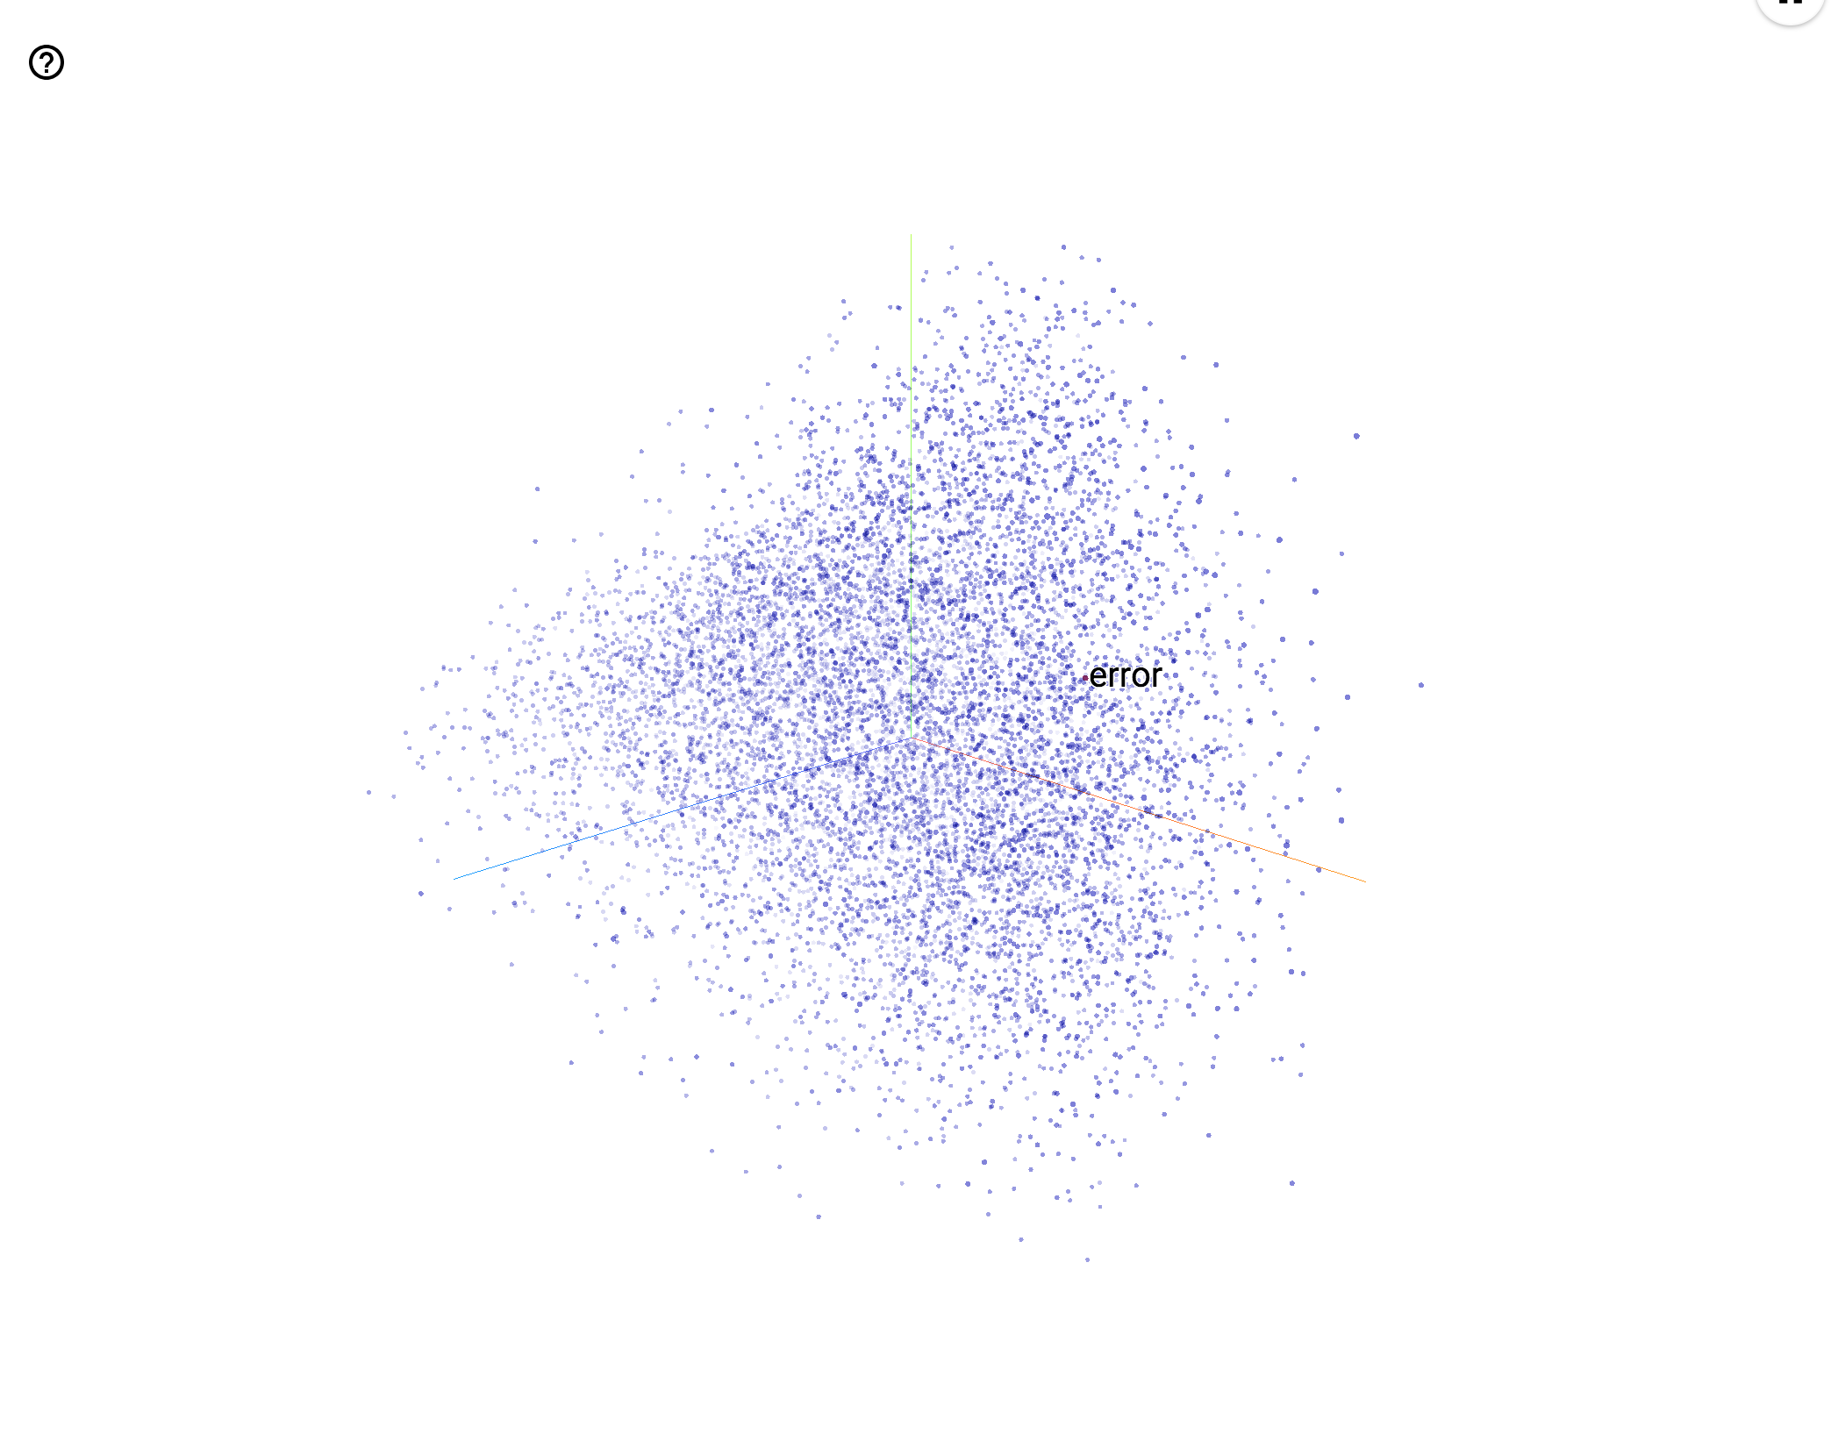
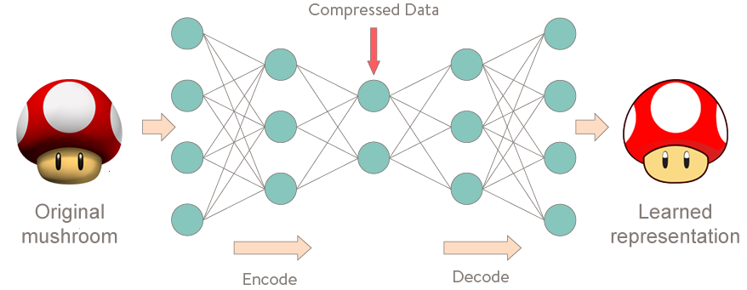
Using Autoencoders to Compress Medical Literature
Dylan Siegler
University School, Hunting Valley, Ohio
Research Question
Introduction
As shown in Figure 2, autoencoders are most easily understood as image compressors. However, this does not mean they don’t work on text. In order to work on text, the text must first be converted to a numerical form. Thus, an intermediary model, called word2vec, is used to convert the text to numbers. This model, written by Google, fits a vector corresponding to each word’s meaning. For example, each word might be represented by a 512-dimensional vector. After training the word2vec, the vectors associated with each word will have semantic meaning. The names of cities or people would be close in vector space and other semantic relationships would be represented by these vectors. The output of the this process is visualized in Figure 4.
This compressed text can then be used downstream. By adding this compressed text to a traditional classification neural network, I can determine if this helps or hurts classification accuracy.
In summary:
Scrape medical literature on colon cancer from arXiv and extract the text from the PDF
Write a basic autoencoder using TensorFlow and Python 3
The autoencoder has 2 layers, the first layer of size 256 and the second of size 128 with a batch size of 256 and input size of 512
Train TensorFlow’s word2vec model on the extracted text with encoding size of 768
Train the autoencoder using batches from the word2vec
Record loss using TensorFlow’s logging program, TensorBoard
Record the cosine similarity between a few semantically similar words to TensorBoard as a sanity check to the training process
Can medical literature improve traditional machine learning classification neural networks for predicting diagnoses.
Computers are the solution to the massive amount of data being published every day. Machine learning, which is a subset of artificial intelligence, learns much like a human; by looking at large amounts of data, the algorithm is able to make generalizations and rules about this data. This means that when it is fed data it has never seen before, the algorithm is able to return the conclusion it has drawn from that data given the generalizations and rules it figured out during training. For example, approximately 10% of all papers on PubMed are on intestinal cancers. This means that if the algorithm were to be trained on these millions of papers (and it could continue to be trained using the approximately 500 papers a day on this subject), the algorithm might be able to look at a patient’s records and determine something such as whether the patient needs surgery, and if so, what type of surgery they should get.
I hope to use machine learning in order to aid doctors in making diagnosis by combining traditional classification algorithms, which involve looking only at a patient’s data, with information gathered from medical literature. However, in order to do this I first have to gather data from medical literature in a format which a neural network downstream will have a good chance at being able to use to improve its predictions. Thus, I have to create an autoencoder neural network in order to properly compress and encode the given medical literature.
Hypothesis
I believe that I will be able to successfully encode medical literature for appropriate use in further neural networks.
Objectives
Develop an autoencoder and stably and successfully train it on medical literature.
Background
Results
A neural network is a type of computer program that roughly simulates the brain in order to perform a variety of tasks. At its core, the neural network is a collection of “neurons.” Each neuron takes in an input in the form of a number and produces an output only if the input is greater than a certain threshold. The outputs between neurons are multiplied by weights (Figure 1).
Figure 1. A visual representation of an ANN with 2 input nodes, 3 hidden layer neurons, and 1 output neuron (Miller).
Discussion
These weights are what are changed during training. A neural network is usually trained by feeding it many examples of the problem it is trying to solve. For each example the neural network runs and produces an output and depending on how wrong that output is, the program changes weights connecting certain neurons in the network. This process has to be repeated on thousands of training examples before the network is nearly at the most optimized place it can be.
Extensive research has been done on information retrieval and question answering neural networks. There have been many proposed models, however, Lew et al. have shown that strong similarity measures and indexing tools have proven to be some of the most effective general strategies (2006). Recurrent neural networks have also been proven effective in the area of question answering; Iyyer et al. demonstrated an effective question answering recurrent neural network that uses an accompanying parsing algorithm (2014). This significantly more structured approach allowed more freedom to explore the information that the model “knew” (2016).
However, given the highly open-ended nature of the data, I believe that such methods would perform poorly in the final task of diagnosing patients. Thus, I have settled on an architecture which is composed of two parts, an autoencoder, which has been used previously to encode text for further use by machine learning algorithms (Yang et al. 2017), and a classification algorithm which will use the encoded literature along with patient data. The classification network is not the focus of this project.
The loss curve did follow an expected, predictable, and non-erratic pattern, which suggests that the training was at least stable. The fact that the cosine similarities of sampled words decreased over time as well only confirmed this. Of course, this says nothing about the effectiveness of the final product, only that the training process has been tuned and dialed in.
Conclusion
Figure 3. This chart shows the loss over time during the training of the autoencoder. The x axis shows time in training steps while the y axis shows loss computed with the Noise Contrastive Estimation loss formula. This run was done with a learning rate of 0.01.
Since there is no objective measurement of accuracy for autoencoders, I instead measured the cosine similarity between some semantically similar words, and this followed the same pattern as the loss.
Currently, it is unclear whether my hypothesis was supported. I did make an autoencoder, but I currently have neither the means nor time to examine its usefulness in full. In the future I hope to use this autoencoder in conjunction with a classifier in order to test if the addition of the medical literature will help in classification. With data gathered from this, I may be able to more accurately assess whether the autoencoder was able to encode the text data to a sufficient standard.
Methods
Acknowledgements &
References
In my project, I plan to use machine learning, more specifically neural networks, to have a computer “read” through medical literature on a particular topic and then the computer will be able to recommend a treatment given finite options.
I have split this task into two parts, “reading” through the literature and seeing if the data gleaned from the papers helps in diagnosing patients. The focus of this project is on the former half. This reading is done through a method called autoencoding. Autoencoding is a form of machine-learning based compression in which a neural network is trained to compress data by minimizing the compression loss. In practice, this means that an hourglass shaped neural network is used.
When text is fed into the input layer, the neural network is forced to find a way to represent this text in a more compact way so that it can pass through the bottleneck. The compressed text is then uncompressed by the neural network and the output is compared to the input. By minimizing the difference between the output and the input, the neural network naturally becomes very good at compressing the given input data. This differs from traditional compression algorithms as this method creates a compression algorithm hand tailored to the given inputs it was trained on, so in essence instead of simply performing some mathematical tricks on the data, the neural network extracts the most important words from the original text.
Andreas J, Rohrbach M, Darrell T, Klein D. 2016. Learning to Compose Neural Networks for Question Answering. [accessed 2017 Apr 9]; https://arxiv.org/pdf/1601.01705.pdf
Iyyer M, Boyd-Graber J, Claudino L, Socher R, Daumé H. 2014. A Neural Network for Factoid Question Answering over Paragraphs.Empirical Methods in Natural Language Processing [accessed 2017 Apr 9]; https://pdfs.semanticscholar.org/2872/52a5fb2f2a9e311eebf06e5ac49eb52eaadc.pdf
Kalyanpur Aditya, Murdock J. 2015. Unsupervised Entity-Relation Analysis in IBM Watson. Proceedings of the Third Annual Conference on Advances in Cognitive Systems [accessed 2017 Apr 9]; http://www.cogsys.org/papers/ACS2015/article12.pdf?cm_mc_uid=32656084035014917521018&cm_mc_sid_50200000=1491755807
Lew MS, Djeraba C, Jain R. 2006. Content-Based Multimedia Information Retrieval: State of the Art and Challenges. ACM Transactions on Multimedia Computing, Communications and Applications [accessed 2017 Apr 9]; 2:1–19. https://pdfs.semanticscholar.org/d0c8/354b7710f50a2e94d28937bca26ab8de456c.pdf
Miller, Steven. Small Neural Network. 2015. Web. 9 Apr. 2017.
Nielsen M. 2017 Jan. Why are deep neural networks hard to train? erastz, G Squared Capital, TinEye, VisionSmarts; [accessed 2017 Apr 9]. http://neuralnetworksanddeeplearning.com/chap5.html
Powers DM. 2011. EVALUATION: FROM PRECISION, RECALL AND F-MEASURE TO ROC, INFORMEDNESS, MARKEDNESS & CORRELATION.Empirical Methods in Natural Language Processing [accessed 2017 Apr 9]; 2:37–63. http://dspace2.flinders.edu.au/xmlui/bitstream/handle/2328/27165/Powers%20Evaluation.pdf?sequence=1
Prager JM, Liang JJ, Devarakonda MV. 2016. SemanticFind: Locating What You Want in a Patient Record, Not Just What You Ask For. IBM Research Division [accessed 2017 Apr 9]; http://domino.research.ibm.com/library/cyberdig.nsf/papers/93F3B60E55AE2D42852580530067E897/$File/rc25627.pdf
Rong X. 2014. word2vec Parameter Learning Explained. [accessed 2017 Apr 9]; https://arxiv.org/pdf/1411.2738.pdf
Valkov, Venelin. What to Do When Data Is Missing? – Part II. 2018. Web. 13 Jan 2019.
Yang Z, Hu Z, Salakhutdinov R, Berg-Kirkpatrick T. 2017. Improved Variational Autoencoders for Text Modeling using Dilated Convolutions. [accessed 2018 Dec 31]; https://arxiv.org/pdf/1702.08139
Zhang Y, Rahman M, Brayla A, Dang B, Chang H-L, Kim H, McNamara Q, Angert A, Banner E, Khetan V, et al. 2016. Neural Information Retrieval: A Literature Review. Clinical Orthopaedics and Related Research [accessed 2017 Apr 9]; 1611.06792. https://arxiv.org/pdf/1611.06792.pdf
I would like to thank Dr. Laux for her help throughout my time as an Anderson Scholar, Mr. Sweeney in advising me in this project, Dr. Dyke for his help in preparing my work, and Mrs. Axelrod for her help throughout my project.
Figure 2. A diagram of an autoencoder with an input layer, 3 hidden layers, and an output layer. This autoencoder is shown compressing and uncompressing an image. (Valkov).
Figure 4. Using Tensorboard’s embedding visualizer feature, you can take the results of the word2vec and visualize them in space. Since word2vec associates a (high-dimensional vector with each word, this visualizer tool runs PCA to reduce these vectors down to 3 dimensions. Thus, each dot represents a word and it’s position in space has a vague correlation with its semantic meaning (the correlation is only vague because PCA was used to take these vectors down from 768 to 3 dimensions, losing a lot of information in the process).

